Slide 1


Furniture Marketing System requirements

Slide 2
Team Members
Ahmed Khaled Elsharabasy
Eslam Saber Elfar
Mazen Hassan Elalfy
Mohammed Ahmed Nasr
Shrouk Sherief Elsweesy.
Omnia Azmy Elqzaz.
Rowida Mohamed Abd El-Aal
Sama Maged Rezq.

Slide 3

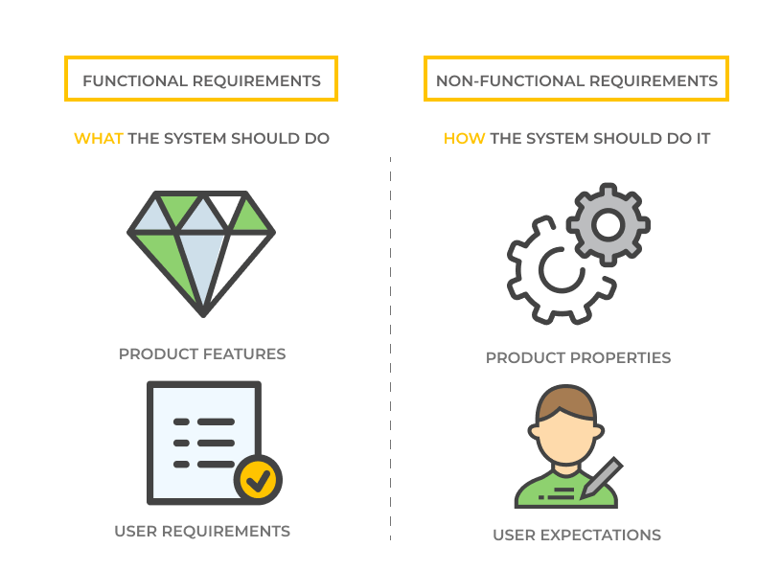
Requirements
Functional
Non-Functional
What The system should do
How The system should do it

Slide 4
Functional Requirements
Management
Client
seller

Slide 5
Management
Manage backup for the system continuously.
Update data of users and store and analyze it.
Add or delete or modify or check user’s account’s information.
Provide Technical support for complaints and modification requests in the system from employees.
Control show or hide products advertisements.
Control permissions of users(clients and sellers).
Control and manage payments and fulfillment of purchase conditions.

Slide 6
Client
Search products.
Choose product specifications from gallery filter.
Browse advertisements to see offers and ads.
Choose product from categories.
Choose payment method.
Add number of orders of product to cart to collect orders, then Buy to purchase product.
Click Remove to remove selected orders from card.
Click Choose your location to determine the delivery location.
Click Buy to purchase and deliver it.
Click number of stars of product rating.
Add review comment about product.
Send complaints to return product if it’s wrong product or it’s not in good condition.
Sending Complaints through mailbox for the management.

Slide 7
Seller
The seller add advertisement.
Sending Complaints through mailbox for the management.
The seller update his personal information and add payment information (Credit account number), company information and product information.

Slide 8
Non-Functional Requirements
Operational
Performance
Security
Cultural & Political

Slide 9
Operational
Cross platforms.
The seller should return the product if it’s wrong product or it’s not in good condition.
The system will be user friendly, consistent, intuitive and descriptive UI.
The system should have a maximum of 2:3 clicks to reach any content.
The system should be evolvable, scalable, testable and maintainable.
Performance
Quick ask & response (under 2 sec).
The system should be available 24 hours a day.
20 minutes are specified daily on a fixed date [3 am (low-intensity hours)] to maintain and update the system.

Slide 10
Security
The system must protect the user’s privacy.
Every user should have a user-customizable visibility policy for his/her personal information such as email and study timetable.
The system will be secure and cannot affect, harm, damage the users or their devices.
Cultural & Political
The system should provide commonly used calendar formats.
The system should use a related time zone.
The system should use the currency of our country.
The system should provide language support for all users.

